Slide 1
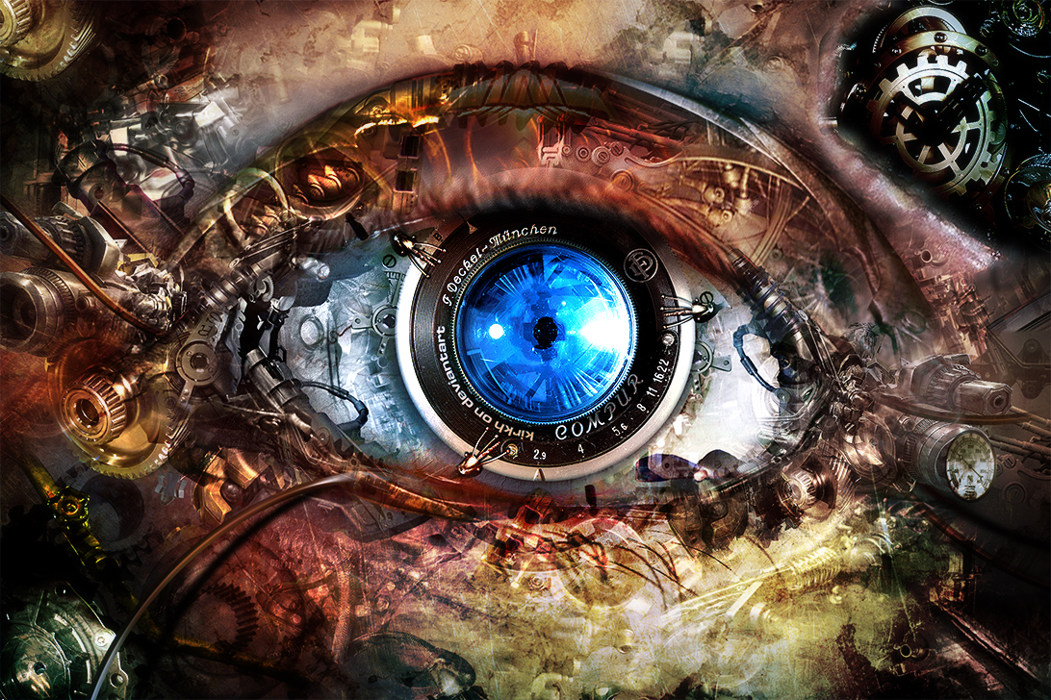
Computer Vision
Disclaimer: All images used in the slides through out have been taken from internet
image: Courtesy James Hays

Slide 2
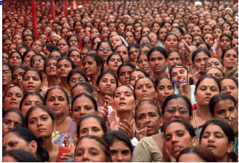
Computer Vision
image: Courtesy Sohaib Khan

Slide 3
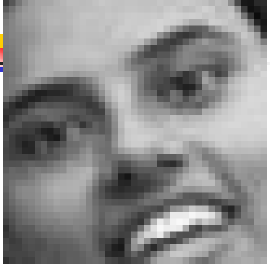
Computer Vision
image: Courtesy Sohaib Khan

Slide 4
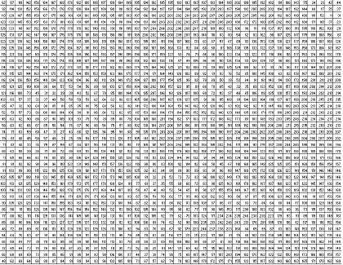
Computer Vision
image: Courtesy Sohaib Khan

Slide 5
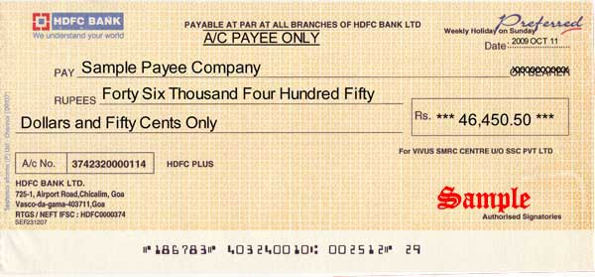
OCR
Check Processing

Slide 6
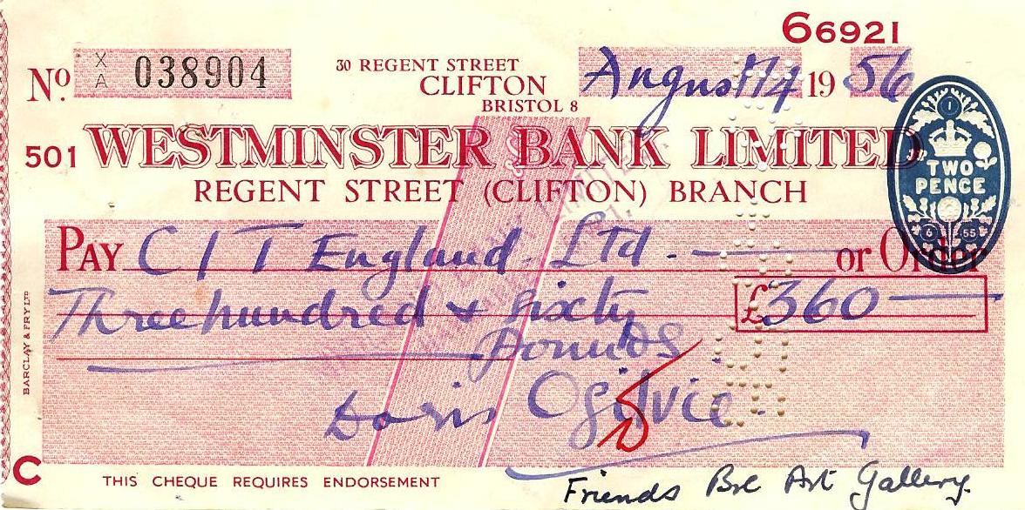
OCR
Check Processing

Slide 7
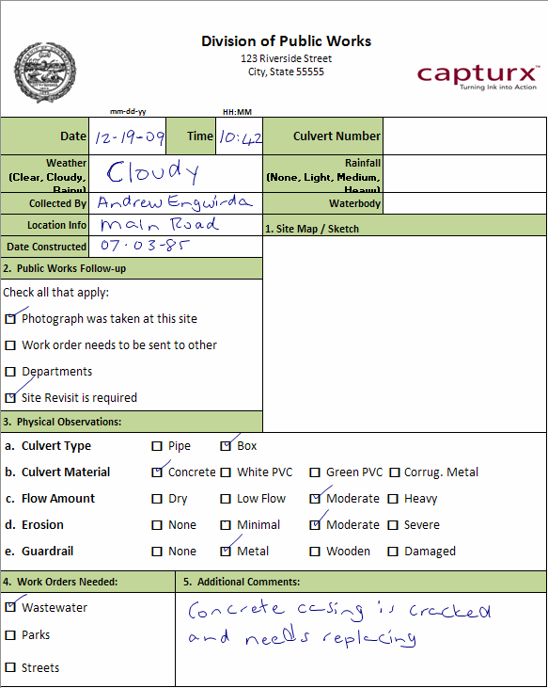
OCR
Form Processing

Slide 8
OCR
Form Processing
Exam Marking
Digitizing/Storage

Slide 9
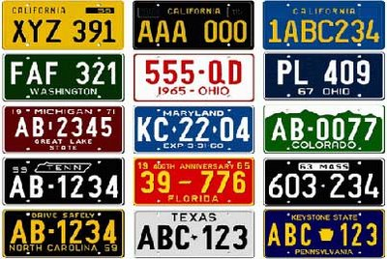
OCR
Number Plates

Slide 10
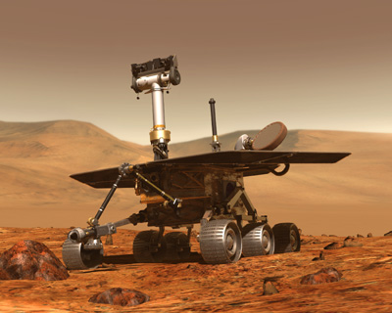
Mars Rover

Slide 11
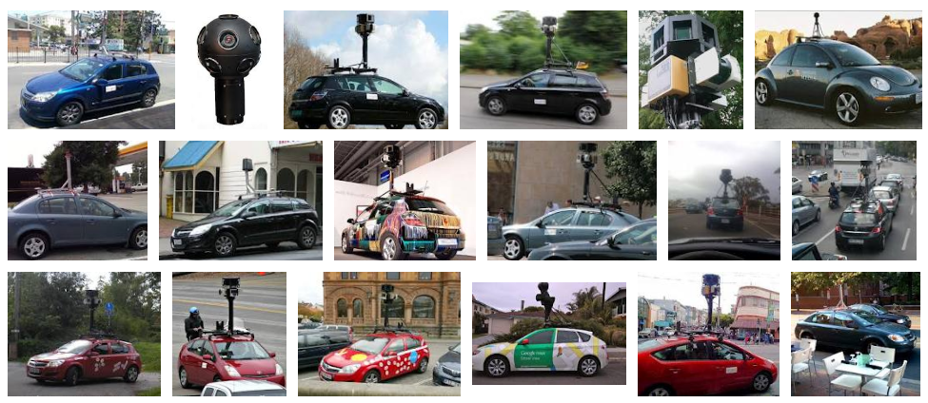
Self Driving Cars

Slide 12
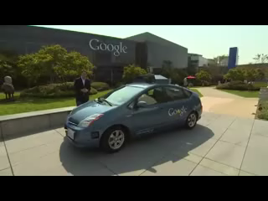
Google Car

Slide 13
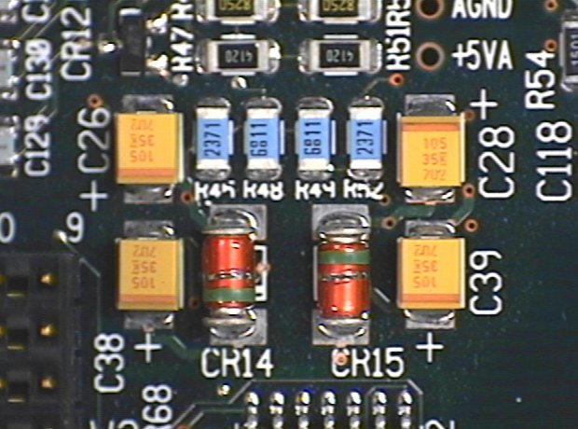

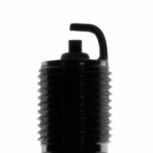
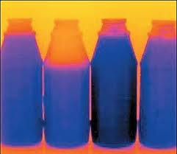
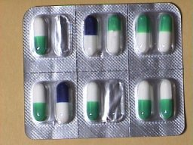
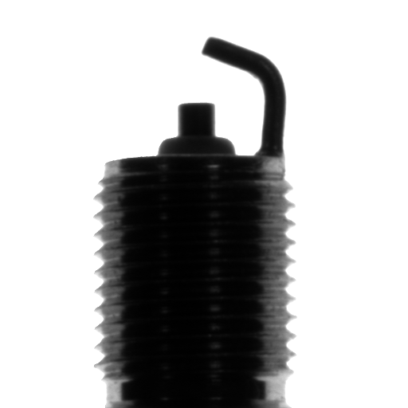
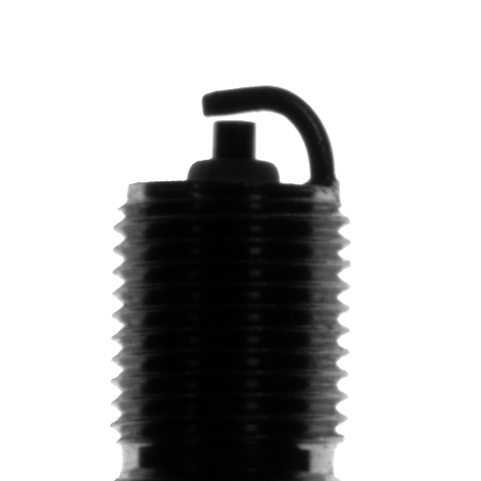
Quality Control

Slide 14
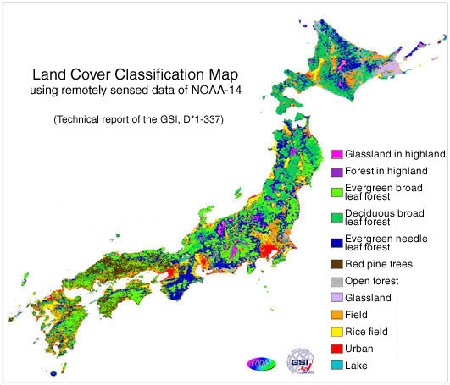
Land Cover

Slide 15
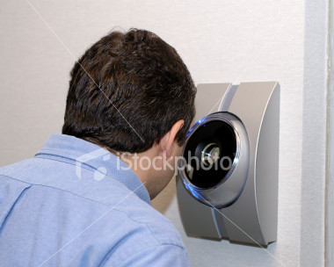
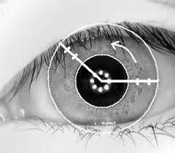
Visual Passwords

Slide 16
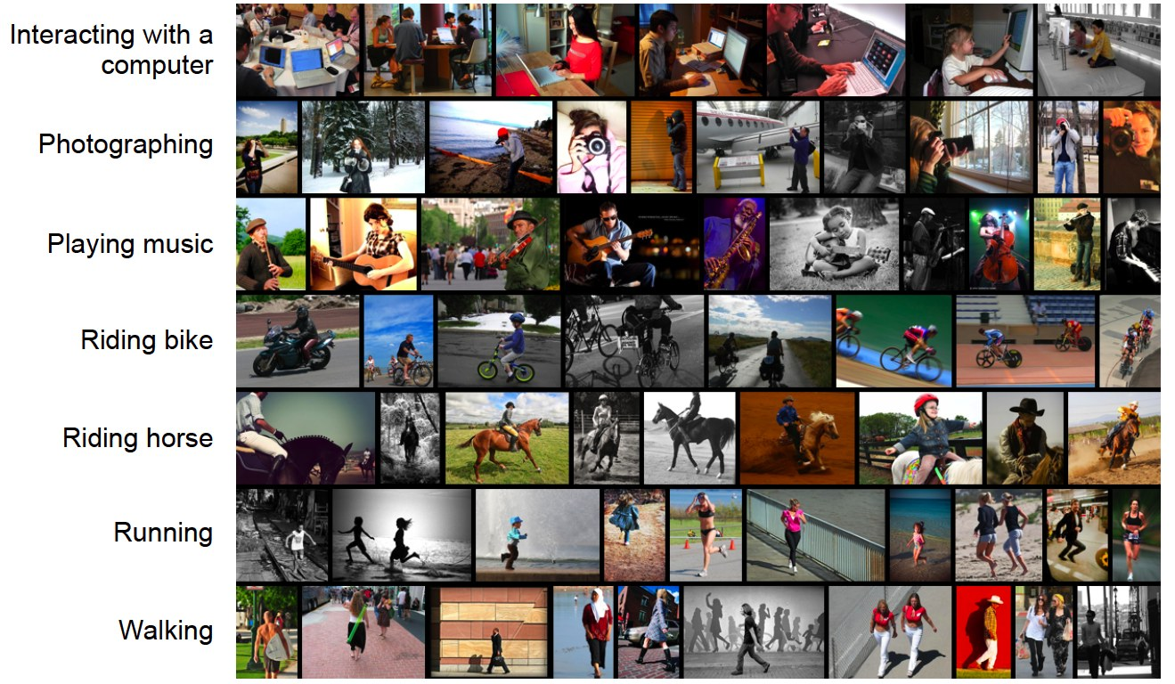
Activity Recognition

Slide 17
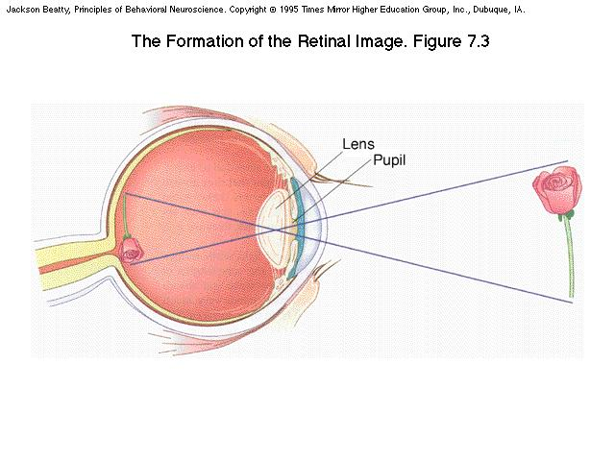
Quick Tour of the course
Human Vision
Pin hole Camera
Digital Images

Slide 18
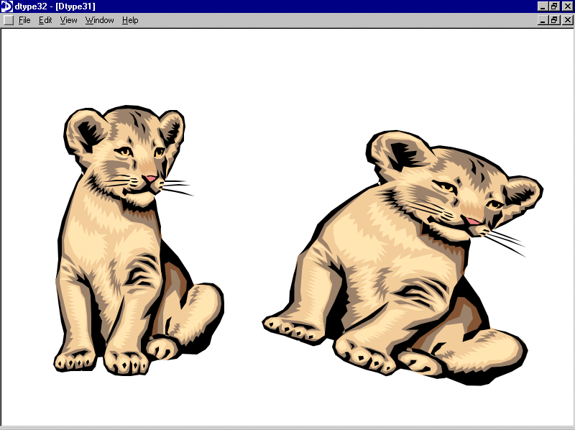
Quick Tour of the course
Image Transforms
Image Registration
Image Warping

Slide 19
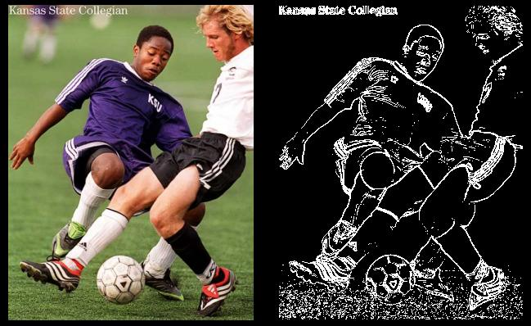
Quick Tour of the course
Edge Detection
Corner Detection
SIFT

Slide 20
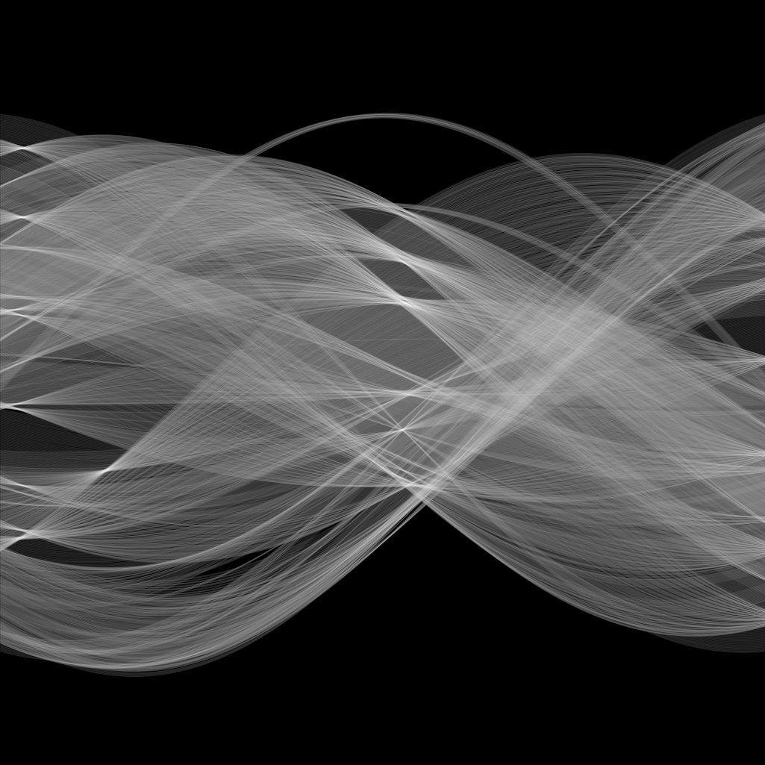
Quick Tour of the course
Hough Transform

Slide 21
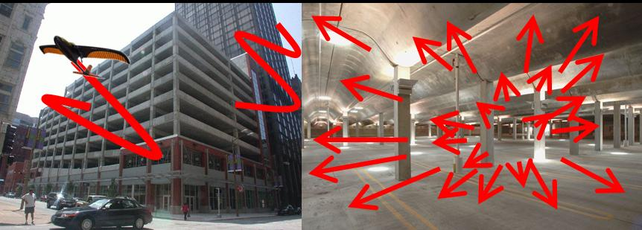
Quick Tour of the course
Motion (Optical Flow)
Motion (Global Flow)

Slide 22
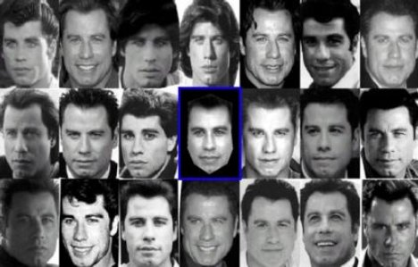
Quick Tour of the course
Face Recognition

Slide 23
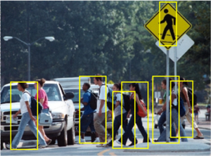
Quick Tour of the course
Pedestrian Detection

Slide 24
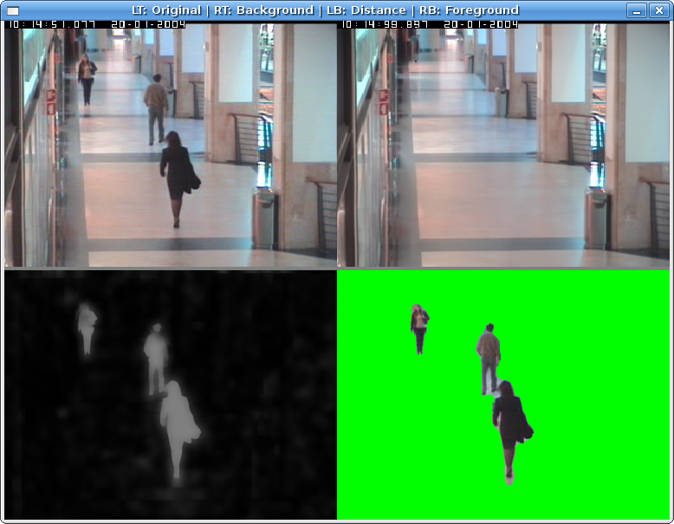
Quick Tour of the course
Background Subtraction

Slide 25
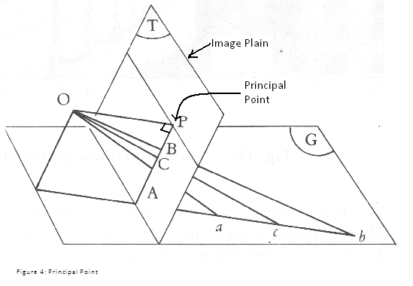
Quick Tour of the course
3D Spatial Transforms
Projective Geometry

Slide 26
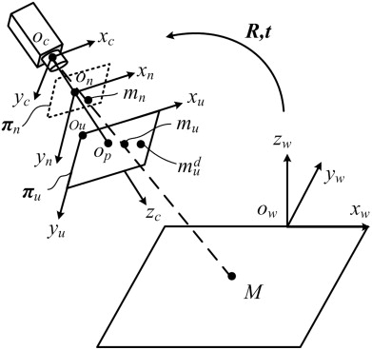
Quick Tour of the course
Camera Models

Slide 27
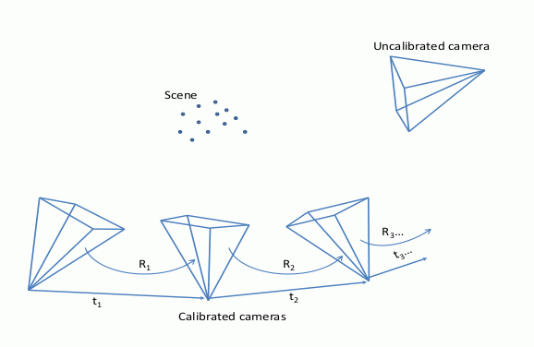
Quick Tour of the course
Camera Calibration

Slide 28
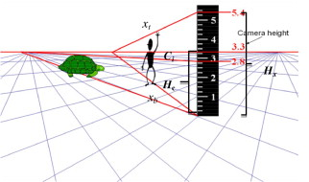
Quick Tour of the course
Single View Meteorology

Slide 29
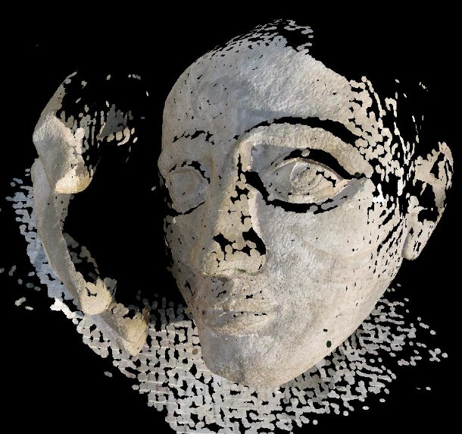
Quick Tour of the course
Epipolar Geometry
Fundamental Matrix
Essential Matrix
Rigid Structure
Non Rigid Structure

Slide 30
Recitations
Linear Algebra
MATLAB
Machine Learning
Convex Optimizations

Slide 31
Grading Policy
Hw-1 3
Hw-2 3
Quiz-1 3
Quiz-2 6
Project 10
Mid-Term 35
Final 40

Slide 32
Reading Material/Books
Fundamentals of Computer Vision by Mubarak Shah, 1992
Computer Vision: Algorithms and Applications by Richard Szeliski
Multiple View Geometry in computer vision by Hartly and Zisserman
Introductory techniques for 3D computer vision by Trucco and Verri
Computer Vision: A Modern Approach by Forsyth/Ponce

